Slide 1
EIS 2017 IR&D
EIS Axios: Cloud Computing Data Processing
2017
Project Status

Slide 2
ASSETS: Cloud Computing
Project Summary
Project Overview
Technical Approach
With their stated intentions to migrate data processing to cloud computing architectures such as IC-ITE, continued viability with our customers requires that we develop tools and approaches to operate in the cloud environment.
The Cloud Computing Data Processing IRAD will take advantage of components, such as EC2, RDS, EMR, and Lambda, provided by cloud computing services for resource allocation
The goal is to create an engine and a framework that will facilitate the addition and integration of processing modules for data analysis and dissemination
The end product will provide:
  Graphical User Interface to configure the system and to manage components
  All basic implementation to interact with the different components from the cloud provider
  A set of API to quickly develop and integrate custom modules to be used on a system
  An engine that will tie them together
  Incorporation of other processing frameworks such as NiFi
We propose implementing this IRAD on AWS. We think this approach is reasonable because of some important government implementations of IC-ITE, such as C2S and GovCloud, are built on AWS
  Back-End Framework Development
    Complete development of the back-end engine that will allow users to allocate resources to specific EC2 instances and to start/stop based upon task load.
  Front-End GUI Development
    Develop a front-end or GUI to allow users to manage modules as well as to command and control running threads
  NiFi Integration
    Integrate NiFi processing threads into CCDP to provide access to all available processors (on the order of hundreds).
  Other Tools Integration
    Incorporate processing technologies such as Machine Learning and Big Data by adding frameworks to the CCDP engine.
Notes:
07/29/17

Slide 3
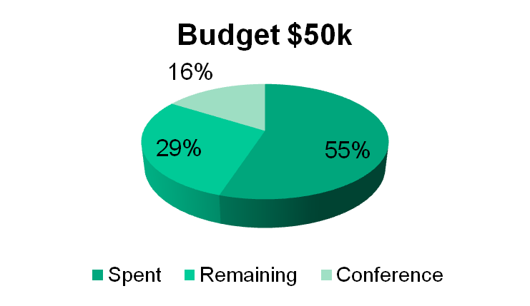
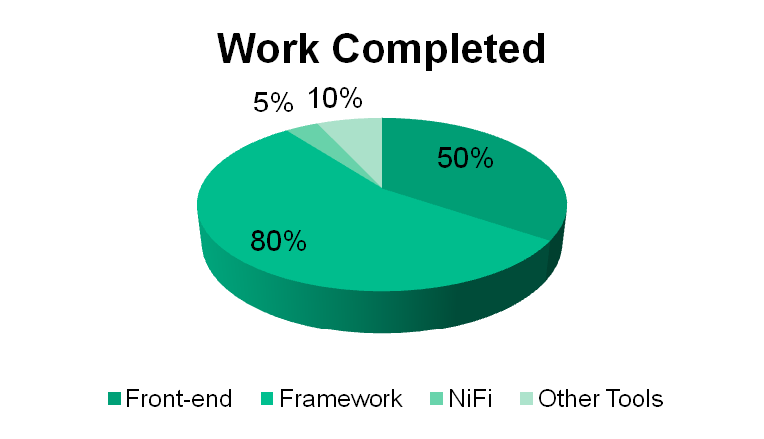
ASSETS: Cloud Computing
Status
Execution Plan
  Back-End Framework Development
    Continue testing and improvements based on feedbacks from current projects running the framework.
    Develop a more generic framework that does not require Mesos.
    Implement additional interfaces to modify engine behavior
  Front-End GUI Development
    Incorporate changes to the JSON messages
    Add feedback received from backend during tasks execution
    Add features to allow users to upload modules
    Add additional features as requested by developers testing the front end (Wish List)
  NiFi Integration
    Integrate NiFi processing threads into CCDP to provide access to all available processors (on the order of hundreds).
  Other Tools Integration
    Incorporate processing technologies such as Machine Learning and Big Data by adding frameworks to the CCDP engine.

Slide 4
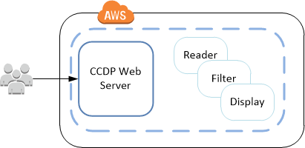
ASSETS: Cloud Computing
Processing Modes: Conventional
  Users login into our Web Server running the framework
  Based on the tasks, the framework deploys EC2 Virtual Machines
  Once all the tasks have been initialized, the thread starts executing
  More EC2 instances are launched if needed
  Once a task finishes processing it notifies the chain of tasks ahead of it
  As the states of the tasks are changing the GUI provides feedback to the user
  All instances except the web server are terminated if they remain idle
  Using this approach we are responsible for making sure resources are available at all time

Slide 5
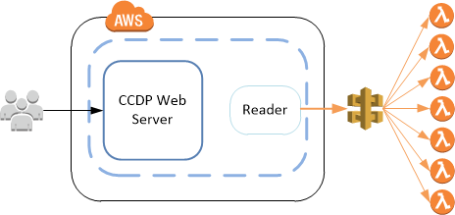
ASSETS: Cloud Computing
Processing Modes: Serveless Computing
  Approach used for short lived tasks
  Users login into our Web Server running the framework
  Based on the tasks, the framework deploys EC2 Virtual Machines
  Once all the tasks have been initialized, the thread starts executing
  Short lived tasks can be executed using AWS lambda functions
  Framework provides API to simplify lambda execution
  AWS is responsible to ensuring there are enough resources to honor all the lambda requests
  Tasks can be executed in parallel
  Cost analysis should be done to choose appropriate processing mode

Slide 6
ASSETS: Cloud Computing
Next Steps
  Add uploading, editing, and removing modules through the GUI
  Enable system administrators to configure the framework through the web
  Continue researching and integrating NiFi into the framework
  Continue incorporating additional big data processing into the framework
  Continue the framework testing and development
  Explore possible uses inside and outside LGS

Slide 7
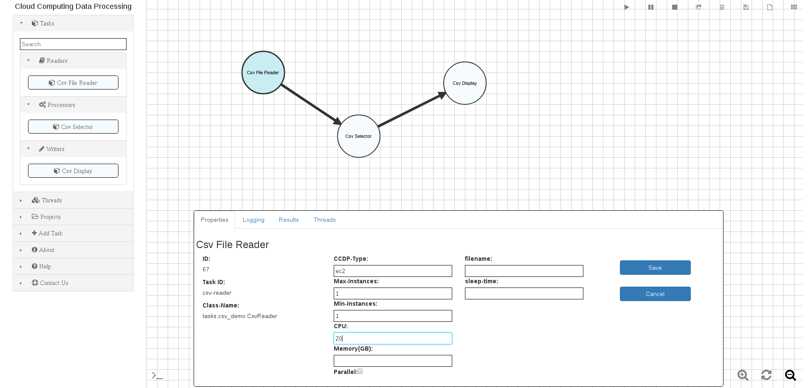
ASSETS: Cloud Computing
Graphical User Interface

Slide 8
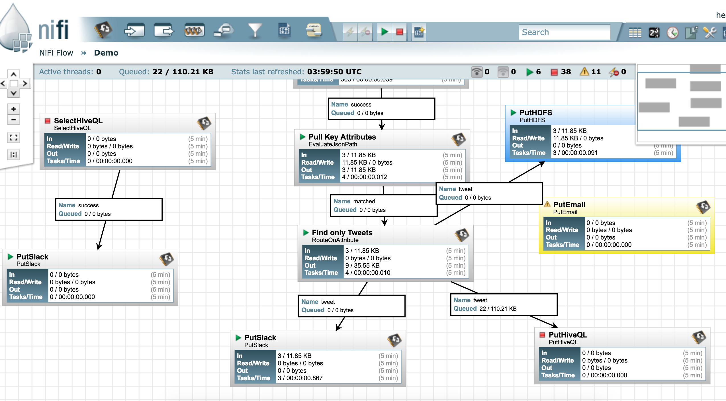
ASSETS: Cloud Computing
NiFi Graphical User Interface

